Slide 1

Pennant Technologies Private Limited
Java Programming Basics

Slide 4
Java is a........ simple programming language one of the most popular programming language open-source and free has a huge community support (tens of millions of developers) close to C & C++ it helps to create modular programs and reusable code write a program once and then run this program on multiple operating systems works on different platforms (Windows, Mac, Linux, Raspberry Pi,etc.) Java is a high-level, object-oriented programming language

Slide 5
JAVA IS USED Mobile applications (specially Android apps) Desktop applications Web applications Gaming Applications Cloud-based Applications Software Tools Database connection And much, much more!

Slide 6
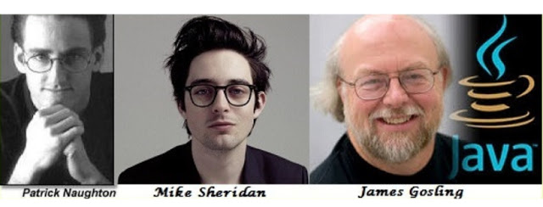
History of Java
Developed by Sun Microsystems Inc in 1991
Initially named as Oak, later changed to Java
First publicly available version – Java 1.0 released in 1995
Oracle corporation acquired Sun Microsystems in 2010
The latest version of Java is Java 14 or JDK 14 released on March, 17th 2020

Slide 7
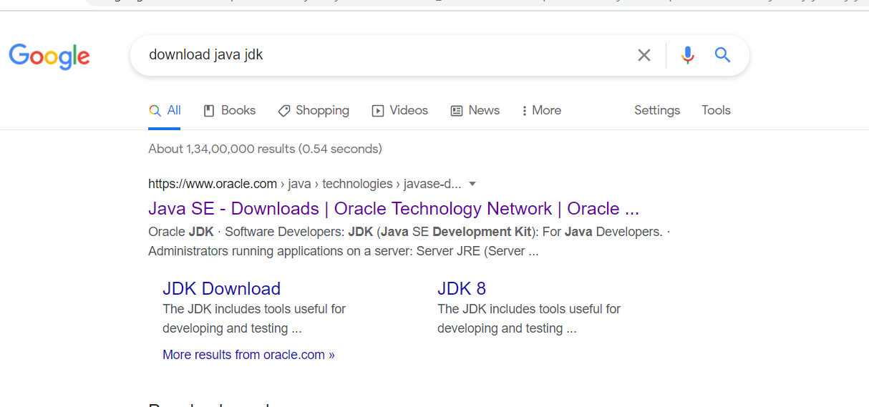
INSTALLATION

Slide 8
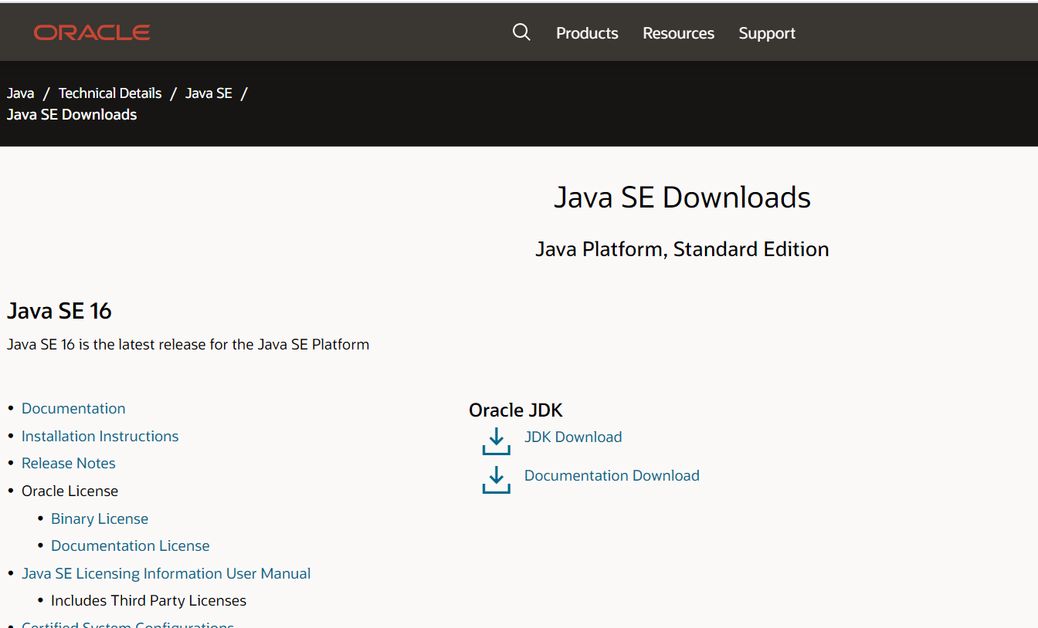

Slide 9
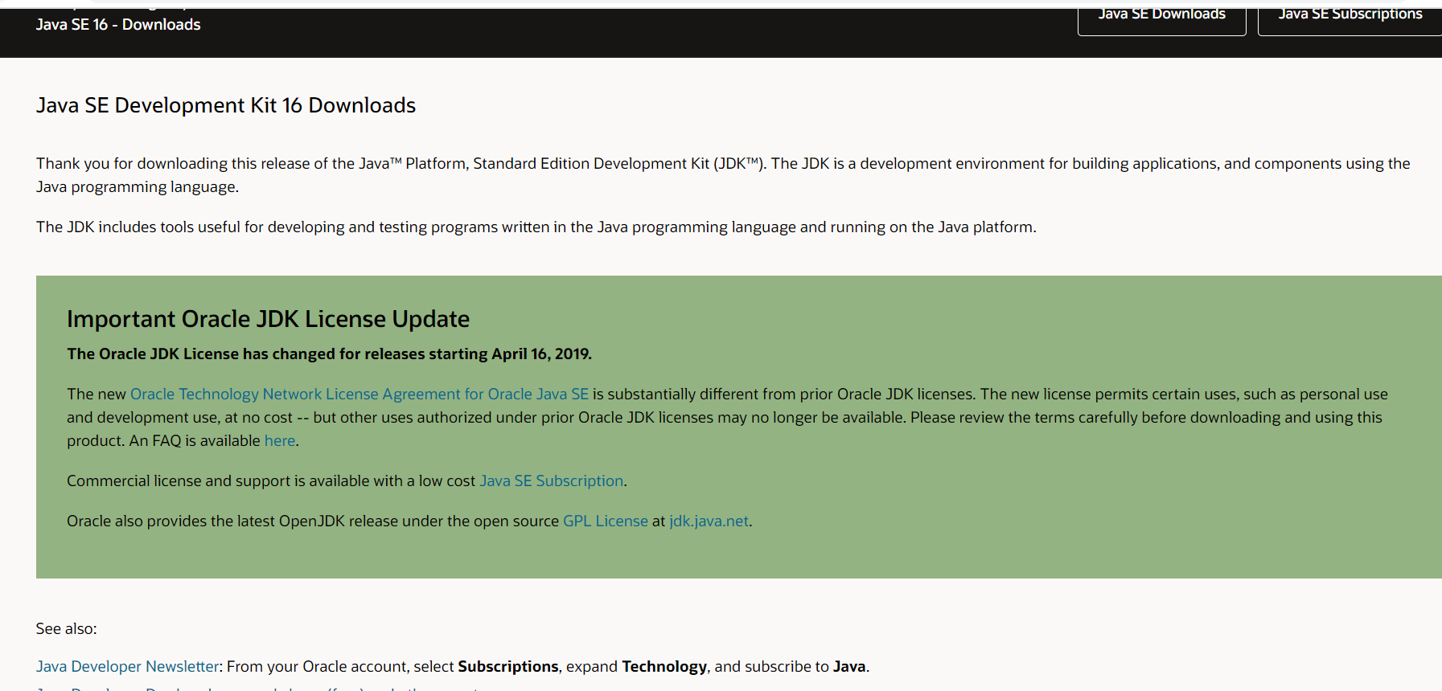

Slide 10
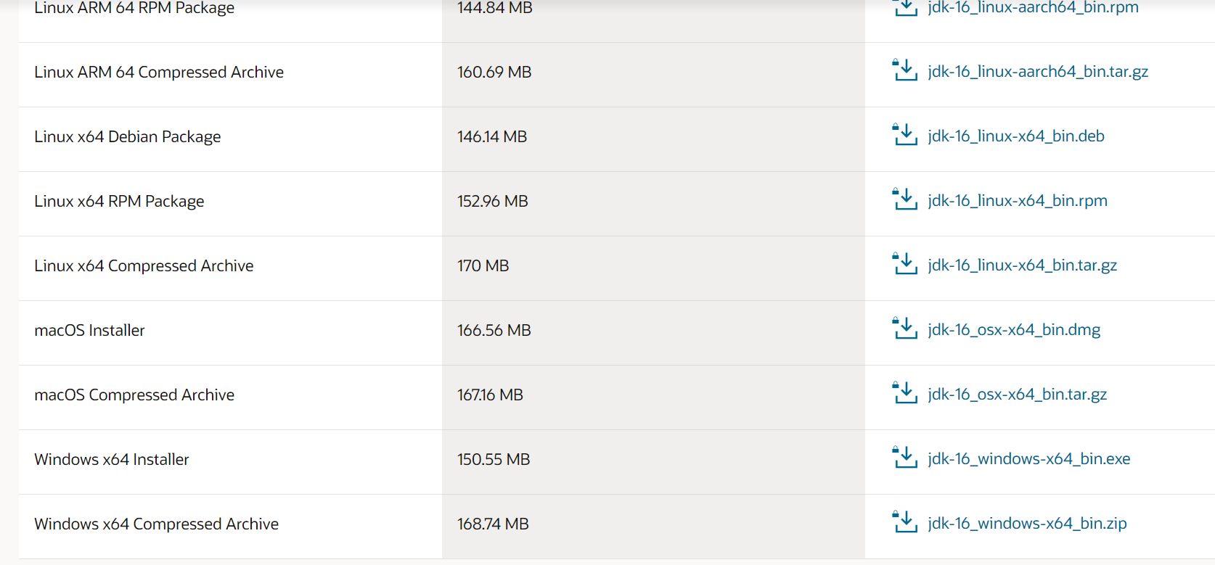

Slide 11
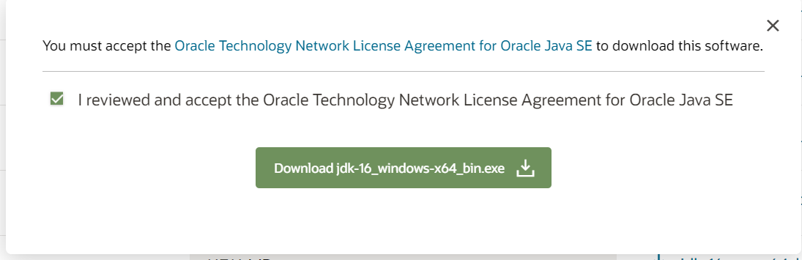

Slide 12
PROGRAMMING LANGUAGES
Programming languages
Procedure oriented proramming language
Object oriented programming language
Procedure Oriented languages
Object Oriented languages

Slide 13
PROCEDURE ORIENTED PROGRAMMING (POP) Large Programs are divided into sequence of functions (Procedures) Each procedure can be called by another procedure during execution by calling it using its name In POP main focus is on procedures only not on data Follows “Top-Down Approach”. Global variables can be accessed by all functions No security to data - Data can be freely moved from one procedure to another procedure If we need to change the type of data of global variable then we need to revise all the functions that are using this global variables. Failing this may result in errors POP does not model real world problems very well. Because functions are action oriented Examples: C, PASCAL, COBOL, BASIC, FORTRAN

Slide 14
OBJECT ORIENTED PROGRAMMING (OOP) In OOP data is secured -does not allow it to flow freely among functions Program is divided into objects and then built functions and data around these objects. object 1
data
functions

Slide 15
POP VS OOP
Procedure Oriented Programming | Object Oriented Programming
Program is divided into smaller programs called Procedures | Program is divided into entities called Objects
Top-Down Approach | Bottom-Up Approach
Importance is given to procedures rather than data | Importance is given to data rather than Procedures/functions
No security to data | Data is Secure
Does not model real-world problems very well | Model real-world problems
Suitable for developing medium size projects | Suitable to developing large size projects

Slide 16
C VS JAVA
C | Java
Procedure Oriented Programming Language | Object Oriented Programming Language
Complied | Complied & Interpreted
Supports Preprocessor Directives | Does not support preprocessor directives
User takes care of memory management | Internally manages the memory
Uses pointers | Does not use pointers
Platform dependent | Platform independent
Variable declaration at the beginning of the block | Variable can be declared anywhere
Uses global variable | No global variable

Slide 17
CHARACTERISTICS OF OOP
Object
Class
Data Abstraction
Encapsulation
Inheritance
Polymorphism
Dynamic Binding
Message Passing

Slide 18
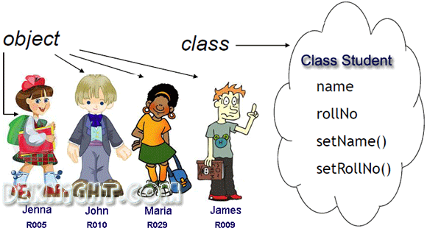

Slide 19
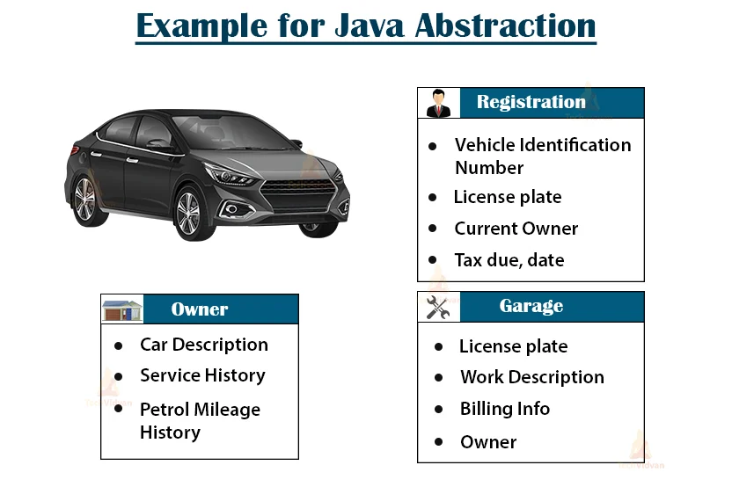

Slide 20
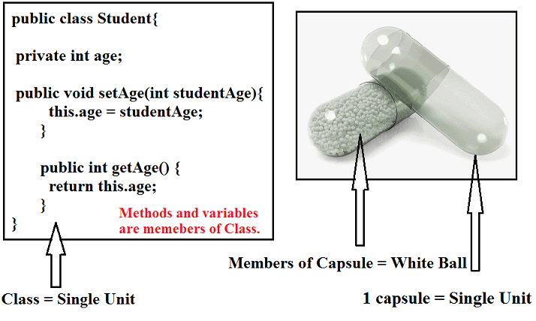
Encapsulation

Slide 21


Slide 22
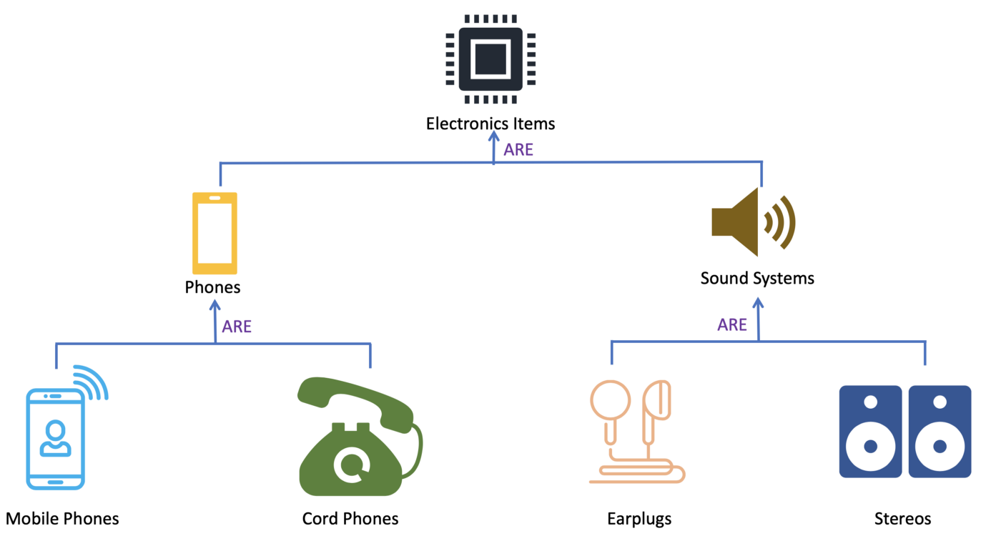

Slide 23
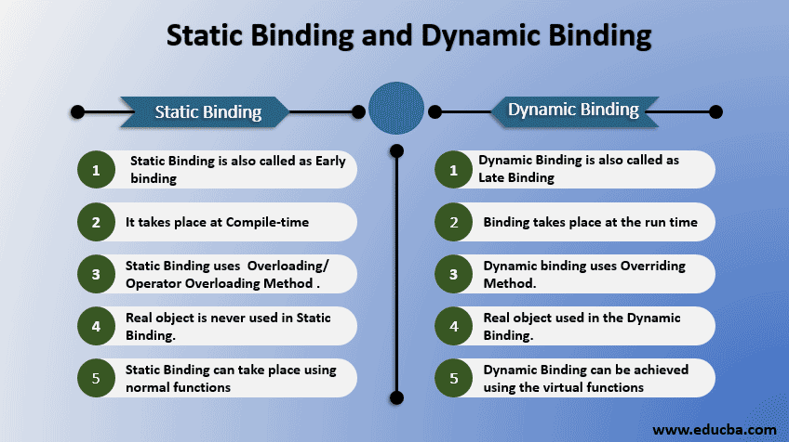

Slide 24
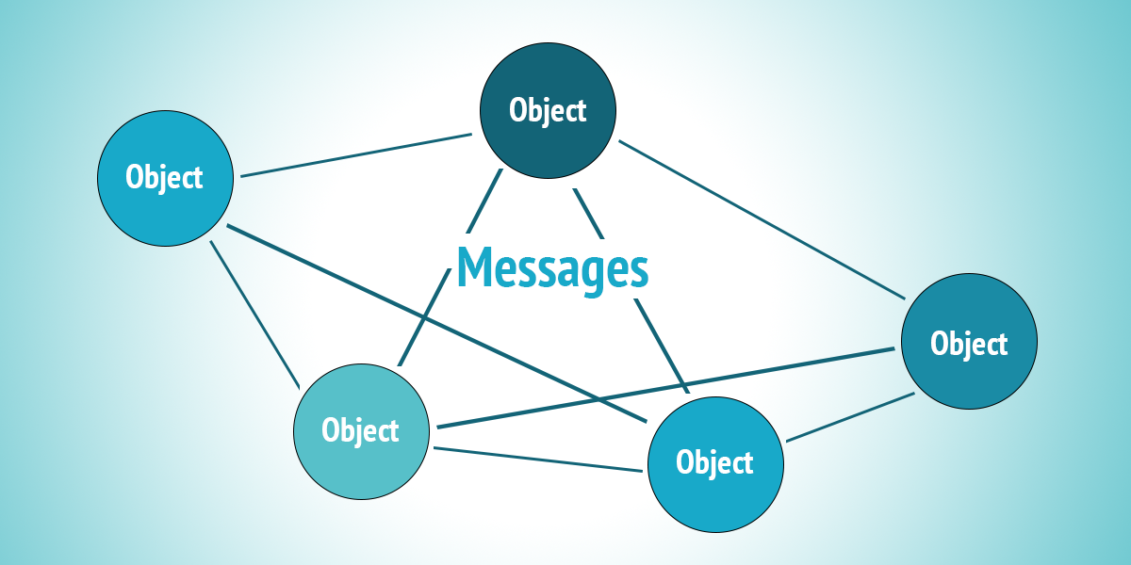

Slide 25
CLASS & OBJECT A class is a data type that allows programmers to create objects. A class provides a definition for an object, describing an object’s attributes (data) and methods (operations). An object is an instance of a class. With one class, you can have as many objects as required. This is analogous to a variable and a data type, the class is the data type and the object is the variable.

Slide 26
DATA ABSTRACTION Data abstraction is the process of hiding certain details and showing only essential information to the user. ENCAPSULATION Encapsulation is a mechanism of wrapping the data (variables) and code acting on the data (methods) together as a single unit. INHERITANCE Inheritance can be defined as the process where one class acquires the properties (methods and fields) of another class. POLYMORPHISM An operation exhibits different behaviors in different instances

Slide 27
DYNAMIC BINDING Dynamic binding also called dynamic dispatch is the process of linking procedure call to a specific sequence of code (method) at run-time. It means that the code to be executed for a specific procedure call is not known until run-time. Dynamic binding is also known as late binding or run-time binding. MESSAGE PASSING Message Passing is nothing but sending and receiving of information by the objects same as people exchange information.

Slide 28
FEATURES OF JAVA Object and Class Data Abstraction Encapsulation Inheritance Polymorphism Dynamic Binding Message Passing Platform independent Compiled and interpreted Robust and secure Distributed and Multi-threading Dynamic and extensible

Slide 29
JAVA BUZZWORDS Platform independent “Write once and run anywhere” Secure Based on public key encryption and helps to design virus free systems Architectural and Neutral Ability of generating Architectural-neutral objects that can run on multiple processors Portable Uses a compiler that is written using ANSI C and POSIX sub suit making it portable Robust Eliminates the most number of errors in the compile time itself Multi-Threading Capable to execute code simultaneously above multiple processors at a time.

Slide 30
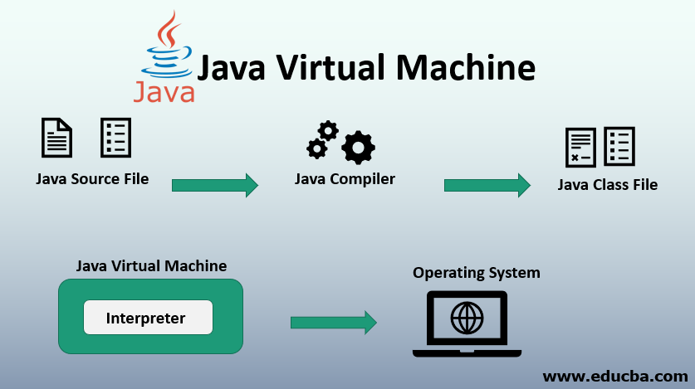

Slide 31
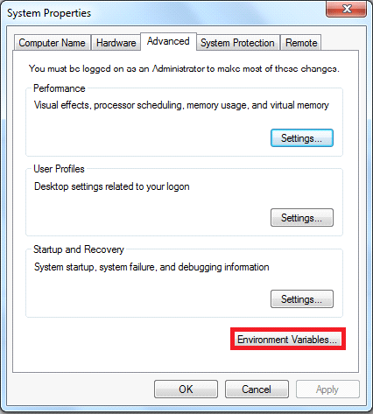

Slide 32
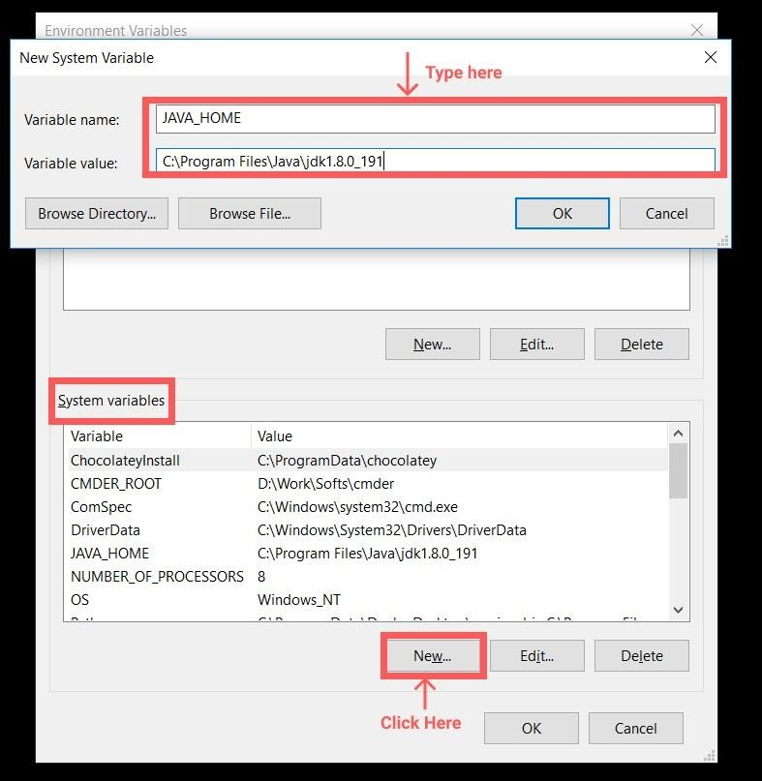

Slide 33
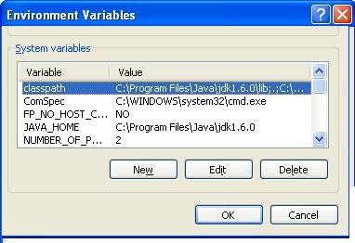

Slide 34
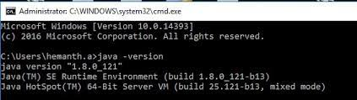
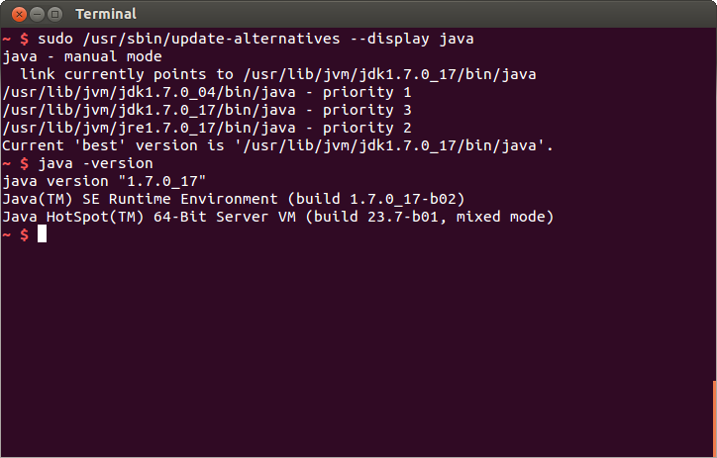
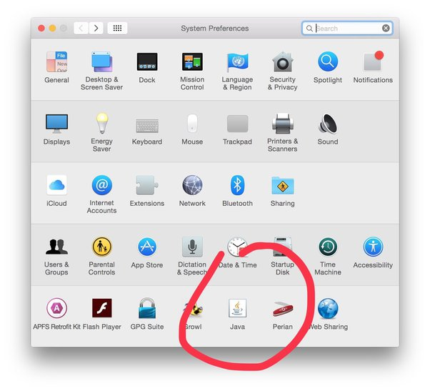

Slide 35
Syntax for java program
simple program
class classname
{
public static void main (String a[])
{
Block of statements
}
}
Note:
Java is case sensitive
class name first letter should be capital
Every statement should end with semicolon
class First
{
public static void main (String a[])
{
System.out.print(“First java program”);
}
}
keywords:
class, public, static, void

Slide 36
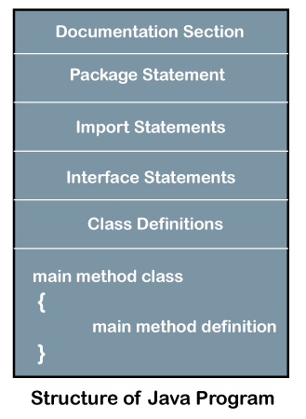

Slide 37
DOCUMENTATION SECTION
Used for writing comment lines
Ignored by compiler
3 ways:
//
This is for single line Ex: //Welcome to Java program
/* */
This is for multiple lines Ex: /* Welcome to
Java Program */
/** */
This is used to generate automatic comment

Slide 38
PACKAGE STATEMENT Java packages are a mechanism to group Java classes that are related to each other, into the same "group" (package) Ex: package Employee IMPORT STATEMENTS To import java package into a class, we need to use java import keyword which is used to access package and its classes into the java program Can import built-in and user-defined packages Ex: import java.lang.Math.*; Import java.util.*; INTERFACE STATEMENTS Used to achieve multiple inheritance

Slide 39
CLASS DEFINITIONS Any number of classes can be defined All the objects of class should be created in main method. One class should have main method—Main method class VARIABLE A Java variable is a piece of memory that can contain a data value. Variables are typically used to store information Variable Declaration: Syntax: datatype variable name; Example: int a; Variable Assignment: Assigning a value to a variable Syntax: variable name=value; Example: a=10;

Slide 40
VARIABLE Variable Naming Conventions: Java variable names are case sensitive. The variable name apple is not the same as Apple or APPLE. Java variable names must start with a letter, or the $ or _ character. After the first character in a Java variable name, the name can also contain numbers (in addition to letters, the $, and the _ character). Variable names cannot be equal to reserved key words in Java. For instance, the words int or for are reserved words in Java. Therefore you cannot name your variables int or fo

Slide 41
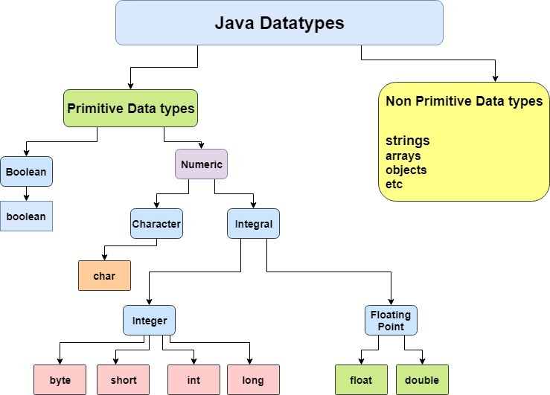

Slide 42
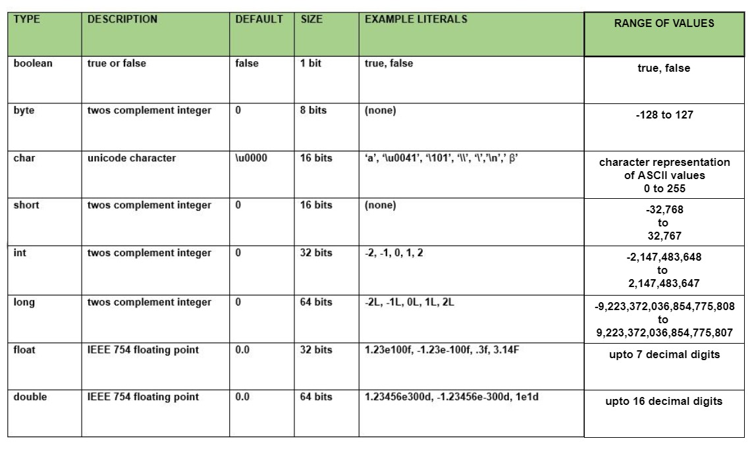

Slide 43
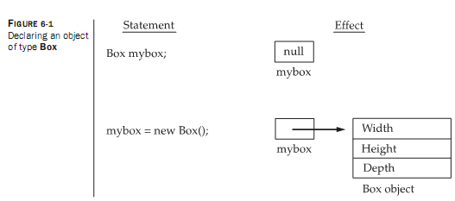

Slide 44
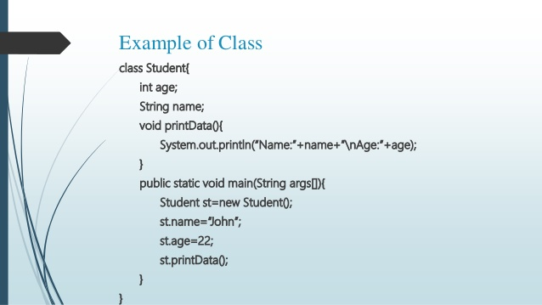

Slide 45
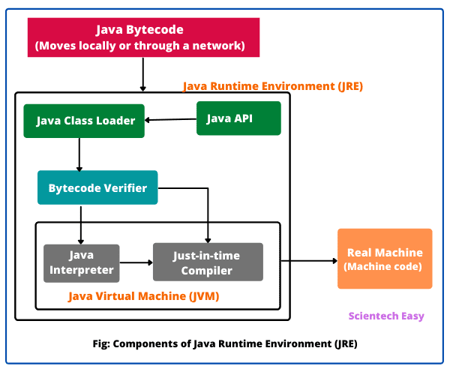

Slide 46
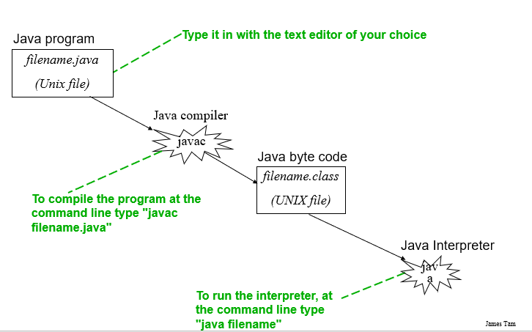

Slide 47
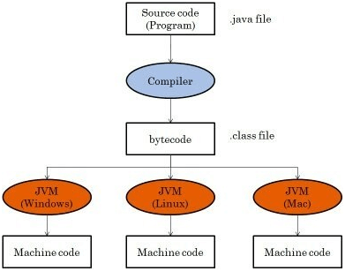

Slide 48
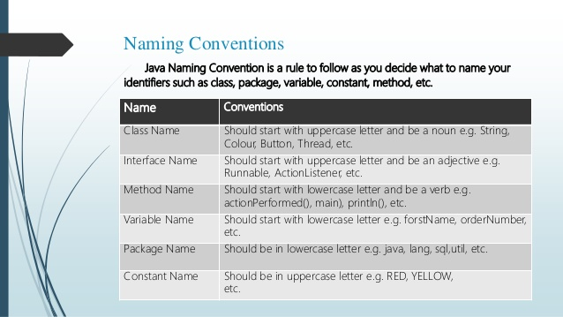

Slide 49
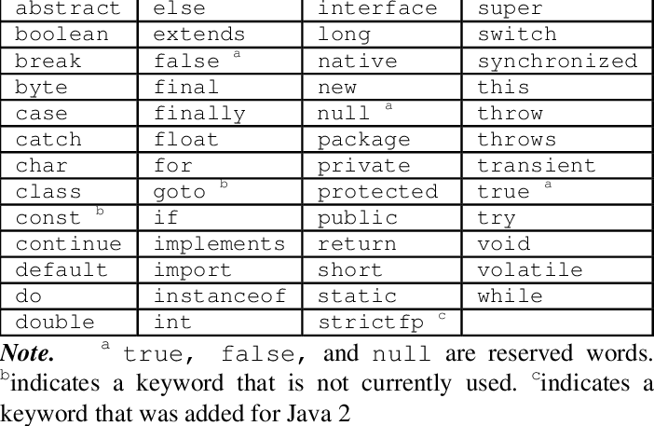

Slide 50
OPERATOR EVALUATION
Parentheses have the highest precedence and it can be used to force an expression to evaluate in order you want.
(3-1) is 2 and(1+1) **(5-2) is 8. you can also use parentheses to make an expression easier to read, as in (min*100)/60, even though it does not change the result.
Exponentiation has the next highest precedence, so 2**1+1 is 3 and not 4 and 3*1**3 is 3 and not 27.
Multiplication and division have the same precedence which is higher than addition and subtraction which also has the same precedence. So 2*3-1=5 and 2/3-1=-1(integer division, 2/3=0).
Operators with the same precedence are evaluated from left to right. So in the expression min*100/60, the multiplication operation takes first place, yielding 5900/60 which in turn yields 98.
If the operations had been evaluated from right to left, the result would have been 59*1 that produce the result as 59 which is wrong

Slide 51
EXAMPLE: 12+20*2-4*2/2.0 # 48.0 1. 12+40-4*2/2.0 2. 12+40-8/2.0 3. 12+40-4.0 4. 52-4.0 5. 48.0 12+(20*2)-4*(2/2.0) # 48.0 12+(20*2)-(4*2)/2.0 # 48.0 expression is evaluated from left -> right. BODMAS(bracket of division multiplication) rule is followed while evaluating the expression.

Slide 52
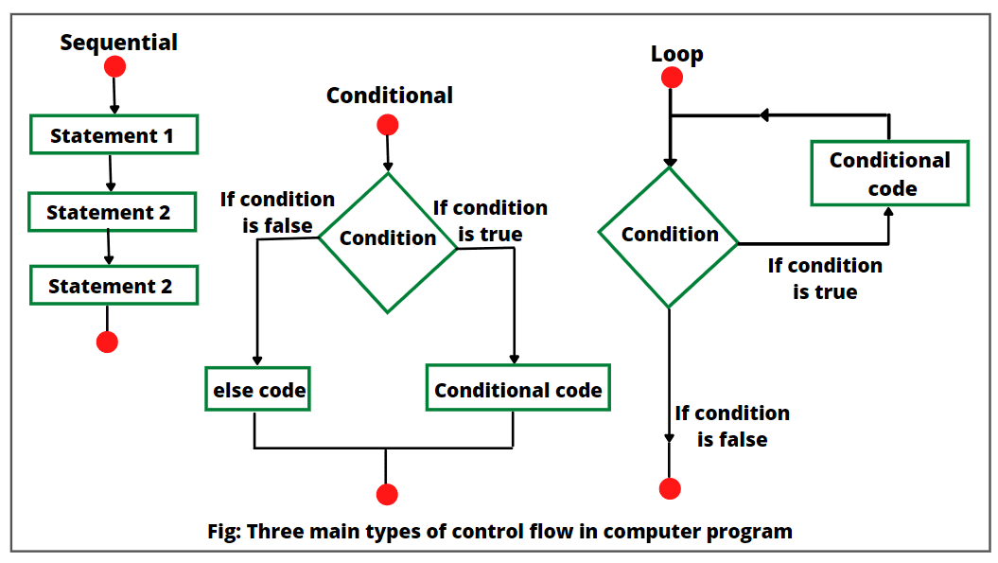

Slide 53
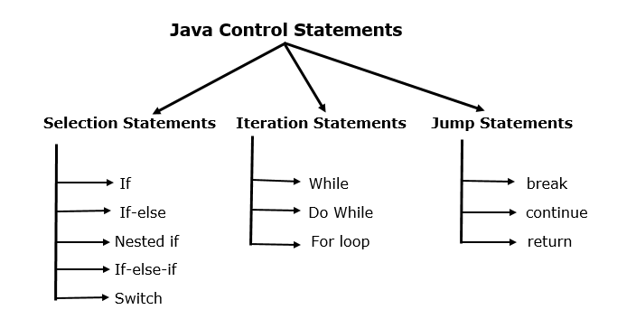

Slide 54
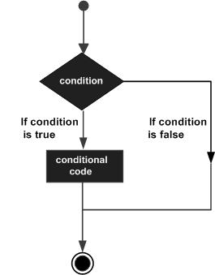
SELECTION STATEMENTS (if)
Syntax:
if(condition)
{
block1- stmt1
block1-stmt2
}
Example
//checking the age
if(age>18)
System.out.print("Age > 18");

Slide 55
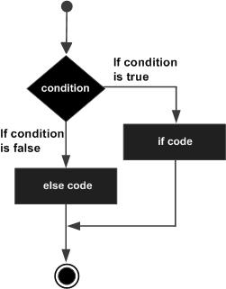
if-else Statement”
Syntax:
if(condition)
{
block1-stmt1
block1-stmt2
}
else
{
block2-stmt1
block2-stm2
}
Example
if( x < 20 )
{
System.out.print(“Yes");
}
else
{
System.out.print(“NO”);
}

Slide 56
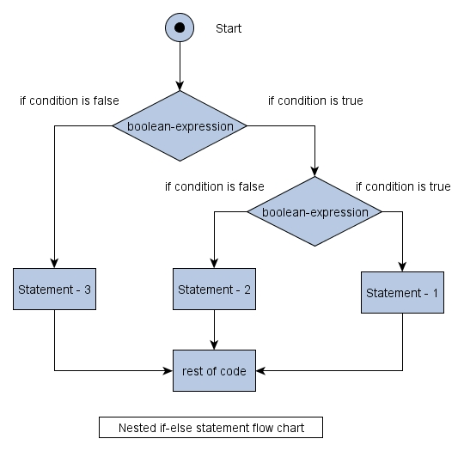
Nested if-else Statement”
Syntax:
if(condition)
{
if(condition)
{
block1-stmt1
block1-stmt2
}
else
{
block2-stmt1
block2-stm2
}
}
else
{
block3-stmt1
block3-stm2
}
}
Example
if( a>b)
{
if(a >c)
System.out.print(“A is big");
else
System.out.print(“b is big");
}
else
{
if(b >c)
System.out.print(“B is big");
else
System.out.print(“b is big");
}

Slide 57
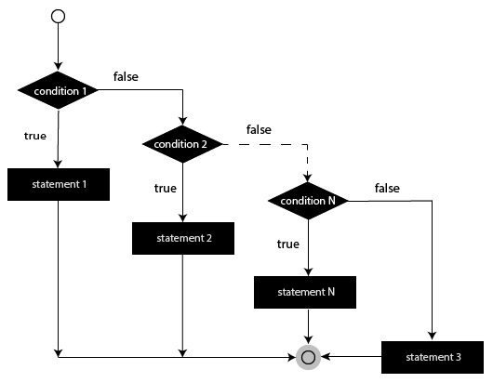
else-if Ladder Statement”
Syntax:
if(condition)
{
block1-stmt1
block1-stmt2
}
else
{
if(condition)
{
block2-stmt1
block2-stmt2
}
else
{
block3-stmt1
block3-stm2
}
}

Slide 58
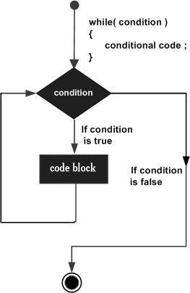
ITERATIVE STATEMENTS (while)
while”
Repeatedly executes the block of statements as long as the condition is true
Entry-controlled Loop
Syntax:
while(expression)
{
block1- stmt1
block1-stmt2
}
Example:
x=0
while( x<10)
{
System.out.println(x);
x=x+1;
}
print(“End of while”)

Slide 59
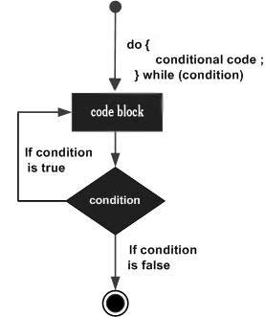
ITERATIVE STATEMENTS (do-while)
Example:
x=0
do
{
System.out.println(x);
x=x+1;
}
while( x<10);
print(“End of do-while”)
“do-while”
Repeatedly executes the block of statements until the condition becomes False
Exit-controlled Loop
Syntax:
do
{
block1- stmt1
block1-stmt2
} while(expression);

Slide 60
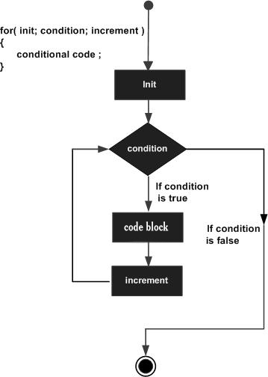
ITERATIVE STATEMENTS (for)
Syntax:
for(initialization; Boolean_expression; update)
{
// Statements
}
Example:
for(int x = 10; x < 20; x = x + 1)
{
System.out.print("value of x : " + x );
}

Slide 61
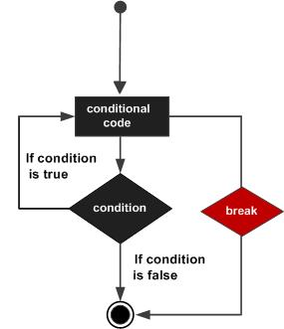
TRANSFER STATEMENTS (break)
“break”
When the break statement is encountered inside a loop, the loop is immediately terminated and the program control resumes at the next statement following the loop.
Syntax: break;
Example:
for(int i = 1; i < 5; i ++)
{
if( i == 3 )
break;
System.out.println( i );
}
Output:
1
2

Slide 62
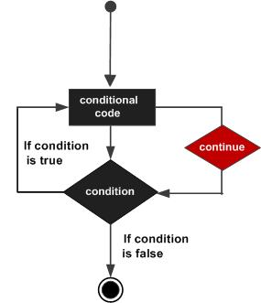
TRANSFER STATEMENTS (continue)
Syntax:
continue;
Example:
for(int i = 1; i < 5; i ++)
{
if( i == 3 )
continue;
System.out.println( i );
}
Output:
1
2
4

Slide 63
PACKAGE DETAILS
Java user input(Scanner)
The Scanner class is used to get user input and it is found in the java.util package.
To use the scanner class, create an object of the class and use any of the available methods found in the scanner class documentation.
There are some input types in Scanner package
nextBoolean() – reads a Boolean value from the user
nextByte() – reads a byte value from the user
nextDouble() - reads a double value from the user
nextFloat() – reads a float value from the user
nextInt() – reads a int value from the user
nextLine() - reads a string from the user
nextLong() – reads a long value from the user
nextShort() – reads a short value from the user

Slide 64
JAVA LANG PACKAGE
For writing any java program, the most commonly required classes and interfaces are encapsulated in the separate packages which is nothing but java.lang package.
It is not required to import java package in our program because it is available by default to every java program.
The following are the some of the important classes present in java.lang package.
Object
String
String buffer
All wrapper classes
Exception API
Thread API…etc.

Slide 65
JAVA.LANG.OBJECT CLASS
For any java object whether it is predefined or customized the most commonly required methods are encapsulated into a separate class which is nothing but object class.
As object class act as a root (or) parent (or) super for all java classes , by default its methods are available to every java class.
The following are the list of all methods present in java.lang object class
public String toString()
public native int hashCode()
public boolean equals(Object o);
protected native Object clone() throws CloneNotSupportedException;
public final Class<?> getClass();
protected void finalize () throws Throwble;
public final void wait() throws InteruptedException;
public final void wait(long ms , int ns) throws InteruptedException;
public final native void notify();
public final native void notifyAll();

Slide 66
ACCESS MODIFIERS
Access modifiers in java specifies the accessibility or scope of the field, method, constructor, or a class.
We can change the access levels fields by applying the modifiers in it.
There are 4 access modifiers in java.
Public- for every where.
Private – only within the class. It cannot be accessed from the outside of the class.
Protected- with in the package and outside the package through child class.
Default – only with in the package.

Slide 67
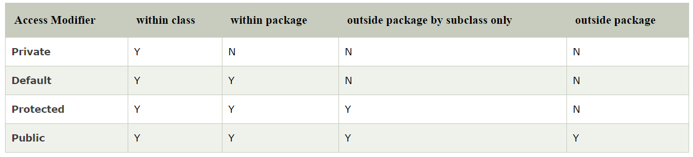

Slide 68
TYPE CONVERSION
Converting one data type into another data type is known as type conversion
This is classified into 2 types
Automatic/ implicit type conversion
Explicit/ manual type conversion
Automatic Type Conversion:
It is possible to convert lower data type into higher data type .
Ex: byte a=5;
int b;
b=a;
This means a is of byte data type and b is int data type. If we write b=a means, a value is stored in b but the value is in int data type.
Explicit Type Conversion:
It is possible to convert higher data type into lower data type. But we may loss data while conversion.

Slide 69
EXAMPLE
Ex: if float is converted into short data type
Float data type occupies 4 bytes of memory
Short data type occupies 2 bytes of memory
So while converting from higher data type to lower data type we lost some data.
Syntax: var= (target) variable;
Ex: float a;
int x;
x=(int) a;
Which means, a is converted into int data type and the result will be stored in x which is already an integer data type.
So we are compressing the size of our data so this is nothing but type casting.

Slide 70
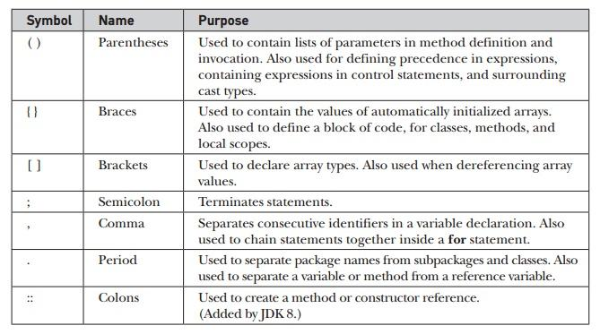
SEPARATORS

Slide 71
WHY ARRAY?
Consider :
int a;
a=10;
System.out.print(“a= “+a);
b=20;
System.out.print(“b= “+b);
Output:
a= 10
b=20
Consider :
int a;
a=10;
a=20;
System.out.print(“a= “+a);
Output:
a= 20
A Variable will hold only one value at a time
Array is used to hold more than one value with same variable name

Slide 72
ARRAY
Java array is an object which contains elements of a similar data type.
The elements of an array are stored in a contiguous memory location.
3 Steps:
Declaration of array
Instantiate the array
Initialization of array

Slide 73
Declaration of Array:
Specifying Array name and datatype
2 forms
Syntax(Form-1):
type array_name[ ];
Example(Form-1):
int roll_no[ ];
Syntax(Form-2):
type[ ] array_name;
Example(Form-2):
int[ ] roll_no;
Don’t Mention the size

Slide 74
Initialization of Array:
Combining declaration and initialization:
Assigning values to the Array.
1. Compile-time:
Assigning individual array elements:
Syntax:
array_name[index]= value;
Example:
int roll_no[ ]=new int[5 ];
Example:
roll_no[0]= 10;
roll_no[1]= 20;
Syntax:
type array_name[ ]= {list of values};
Example:
int roll_no [ ]= {10,20,54,66,12};
In this case required memory will be automatically created, no need of “new” operator

Slide 75
Initialization of Array:
To print array values
Reading values from user- Run-time
uses Scanner class (import java.util.*)
To read a variable value
int a;
Scanner s;
a=s. nextInt( );
To read array values
int a[]=new int[5];
Scanner s;
for(i=0;i<5;i++)
{
a[i]=s. nextInt( );
}
Using for or foreach
for(i=0;i<5;i++)
{
System.out.println(a[i]);
}
for(int i : a)
{
System.out.println( i);
}

Slide 76
ONE-DIMENSIONAL ARRAY
Combining Declaration & Instantiate the Array:
Syntax:
type array_name[ ]= new type[ size];
Example:
int roll_no[ ]=new int[5 ];
Initialization:
Syntax:
type array_name[ ]= {list of values};
Example:
int roll_no [ ]= {10,20,54,66,12};
Example:
int a[]=new int[5];
Scanner s= new Scanner(System.in);
for(i=0;i<5;i++)
{
a[i]=s. nextInt( );
}

Slide 77
TWO-DIMENSIONAL ARRAY
used to store more than one value
used to represent data in the form of matrix and tables
Declaration of Array:
Specifying Array name and data-type
Syntax:
type-array[][];
Example:
int a[][];
Instantiate the Array:
Allocating the memory to the array
uses “new” operator
Syntax:
array_name= new type[ r-size][c-size];
Example:
a=new int[3][4];
Syntax:
type array_name[ ][ ]= new type [ r-size][c-size];
Example:
int a[ ][ ] = new int[3][4];
Memory Allocation:
Individual element is accessed:
a[r-index][c-index]
First element: a[0][0]
Second element: a[0][1]
Third element: a[0][2]
12th element: a[2][3]

Slide 78
TWO-DIMENSIONAL ARRAY
Initialization of Array:
Assigning values to the Array.
1. Compile-time:
Assigning individual array elements:
Syntax:
array_name[r-index][c-index]= value;
Syntax:
array_name[r-index][c-index]= value;
Syntax:
array_name[r-index][c-index]= value;
Example:
int a[ ][ ]=new int[3 ][4];
Example:
a[0][0]= 10;
a[0][1]= 20;
a[1][2]=65;
a[2][3]=35;

Slide 79
TWO-DIMENSIONAL ARRAY
Combining declaration and initialization:
Syntax:
type array_name[r-size][c-size]= {list of values};
Example:
int a[3][2]= {10,20,54,66,12,77};
Example:
int a[3][2]= {{10,20},{54,66},{12,77}};
In this case required memory will be automatically created, no need of “new” operator
a[0][0] = 10 a[1][0] = 54 a[2][0] = 12
a[0][1] = 20 a[1][1] = 66 a[2][1] = 77
Values will be stored row by row

Slide 80
To print array values
Initialization of Array:
Reading values from user- Run-time
uses Scanner class (import java.util.*)
int a[][]=new int[3][2];
Scanner s= new Scanner(System.in);
for(i=0;i<3;i++)
{
for (j=0; j<2;j++)
{
a[i][j]=s. nextInt( );
}
}
for(i=0;i<3;i++)
{
for (j=0; j<2;j++)
{
System.out.println(a[i][j]);
}
}

Slide 81
MULTI-DIMENSIONAL ARRAY
The Multi Dimensional Array in Java programming language is nothing but an Array of Arrays (Having more than one dimension).
Two Dimensional Array, which is the simplest form of Java Multi Dimensional Array.
we can declare n-dimensional array or Muti dimensional array by placing n number of brackets [ ], where n is dimension number.
3D-Array Declaration:
Syntax:
type array_name[ ][ ][ ];
Example:
int a[ ][ ][ ];
Instantiate the 3D-Array:
Syntax:
array_name= new type[Tables][ r-size][c-size];
Example:
a= new int[2][ 3][4];

Slide 82
MULTI-DIMENSIONAL ARRAY
Initialization of Array:
Assigning values to the Array.
1. Compile-time:
Assigning individual array elements:
Syntax: array_name[table_no][r-index][c-index]= value;
Example: int a[ ][ ][ ]=new int[2][ 3][4];
Example:
a[0][0][0]= 10;
a[0][0][1]= 20;
a[1][1][2]=65;
a[1][2][3]=35;
Combining declaration and initialization:
Syntax: type array_name[tables][r-size][c-size]= {list of values};
Example: int a[2][3][2]= {{ {5,6},{8,12},{7,90}} , {{10,20},{54,66},{12,77}}};
In this case required memory will be automatically created, no need of “new” operator

Slide 83
Initialization of Array:
To print array values
Reading values from user- Run-time
uses Scanner class (import java.util.*)
int a[][][]=new int[2][3][4];
Scanner s= new Scanner(System.in);
for(i=0;i<2;i++)
{
for (j=0; j<3;j++)
{
for(k=0;k<4;k++)
{
a[i][j][k]=s. nextInt( );
} } }
for(i=0;i<2;i++)
{
for (j=0; j<3;j++)
{
for(k=0;k<4;k++)
{
System.out.print(a[i][j][k]);;
}
}
}

Slide 84
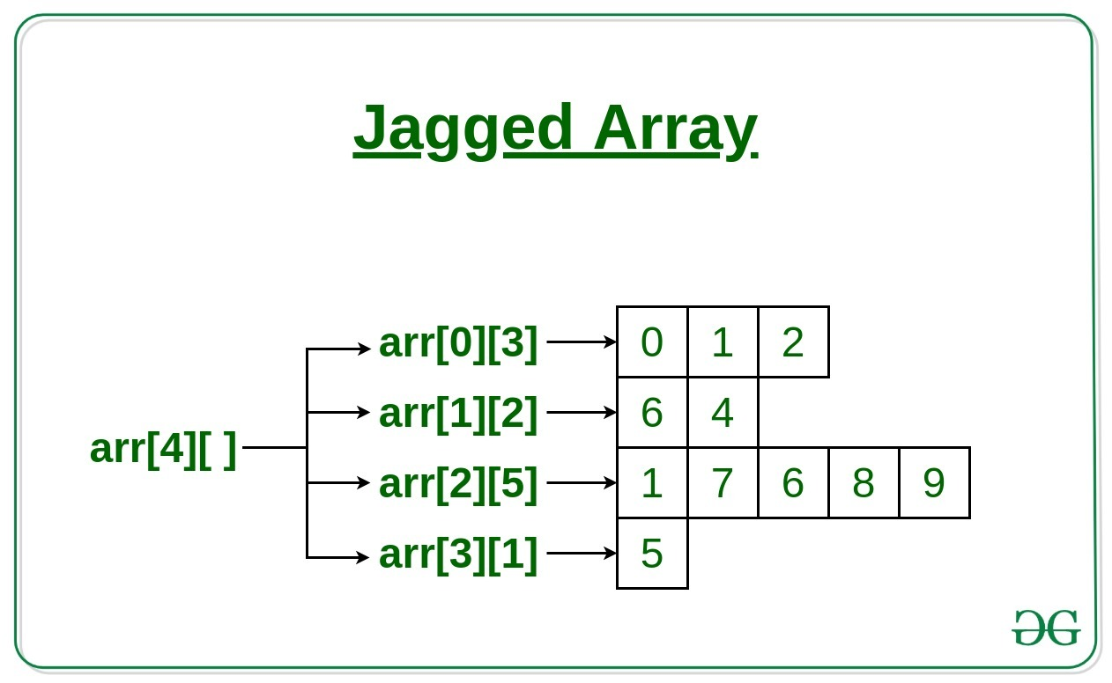
JAGGED ARRAY
Jagged array is a multidimensional array where member arrays are of different size.
For example, we can create a 2D array where first array is of 3 elements, and is of 4 elements.
Program:
int a[ ][ ];
a=new int[3][ ];
a[0]=new int[4];
a[1]=new int[2];
a[2]=new int[3];

Slide 85
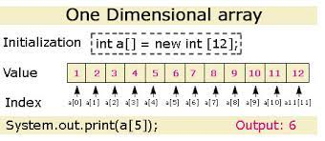
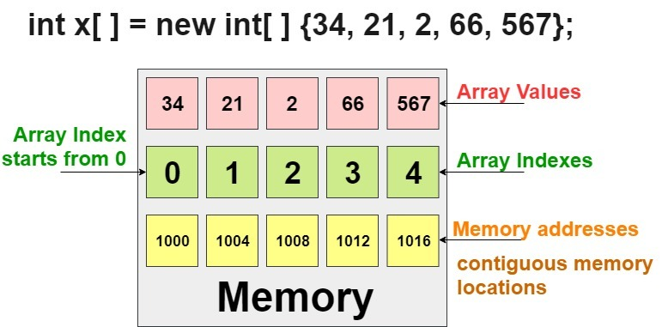

Slide 86
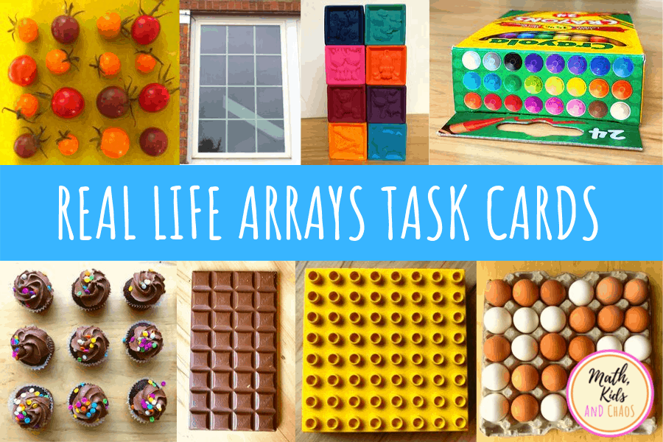


Slide 87
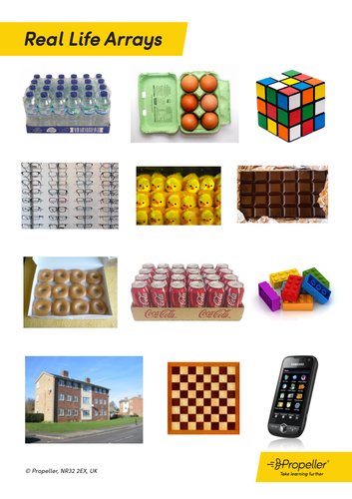
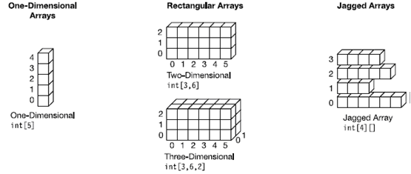

Slide 88
ARRAY PACKAGE
Array class is included in java.util package
It contains several static methods that you can use to compare, sort and search in arrays.
This class is a member of collection framework.
Different methods of this class are listed below.
Arrays.toString()
Arrays.asList()
Array.sort()
Array.binarySearch()
Array.copyOf()
Array.copyOfRange()
Arrays.fill() … etc.

Slide 89
METHODS IN ARRAYS
Arrays.ToString():
It returns the string representation of the array enclosed in the square braces[].
Adjacent elements are separated by the comma character.
Ex: int array[]={1,2,3,4,5,6,7};
System.out.println(Arrays.ToString(array));
Arrays.asList():
It returns a list backed by a given array . In other words, both the list and array refer to the same location
Ex: List integerList= Array.asList(array);// returns a fixed size list backed by the specified array.
Arrays.sort():
This method sorts the specified array into ascending numerical order.
Arrays.sort(array)

Slide 90
METHODS IN JAVA
Arrays.binarySearch():
It returns an integer value for the index of the specified key in an specified array. It returns a negative number if the key is not found and for this method to work properly , the array must be sorted.
Ex: int idx= Arrays.binarySearch(baseArray,21);
Arrays.copyOf():
This method copies the specified array, truncates or pads with zeros so the copy has the specified length.
Ex: int copyOfArray= Arrays.copyOf(baseArray,11);

Slide 91
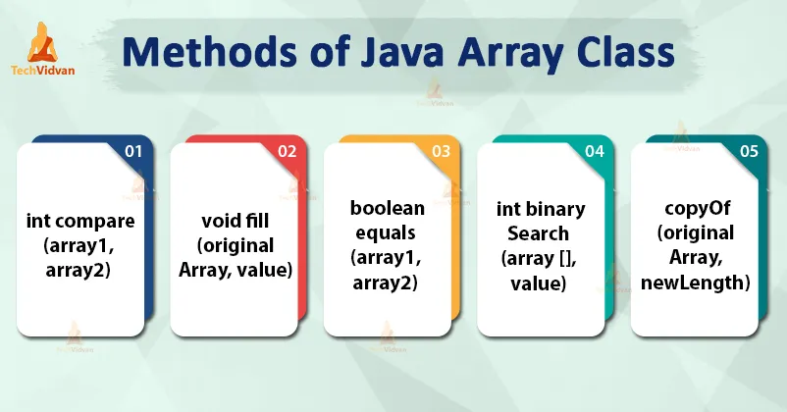

Slide 92
STRINGS
Java string is a sequence of characters. They are objects of type String.
Once a String object is created it cannot be changed. Strings are Immutable.
Creating an empty string.
String s = new String();
String str = "abc";
is equivalent to:
char data[] = {'a', 'b', 'c'};
String str = new String(data);
Construct a string object by passing another string object.
String str2 = new String(str);

Slide 93
STRING METHODS
length()
charAt()
equals()
equalsIgnoreCase()
startsWith()
endsWith()
compareTo()
compareToIgnoreCase()
indexOf()
lastIndexOf()
substring()
concat()
replace()
toLowerCase

Slide 94
STRING METHODS
length():
This method returns the length of the string
System.out.println(“Hello”.length()); //prints 5
String str1 = “CSE Department”
int a=str1.length(); //a=14

Slide 95
STRING METHODS
charAt( ):
Returns the character at the specified index. An index ranges from 0 to length() - 1. The first character of the sequence is at index 0, the next at index 1, and so on, as for array indexing.
char ch;
ch = “abc”.charAt(1); // ch = “b”
String str1 = “CSE Department”
char ch1;
ch1 = str1.charAt(4); // ch = “D”

Slide 96
STRING METHODS
equals( ):
Returns true if the invoking string contains the same character sequence.
String str1 = “CSE Department”;
String str2 = “IT Department”;
if(str1.equals(str2))
System.out.println(“str1 and str2 are equal”);
else
System.out.println(“str1 and str2 are unequal”);

Slide 97
STRING METHODS
equalsIgnoreCase( );
Compares this String to another String, ignoring case considerations.
String str1 = “CSE DEPARTMENT”;
String str2 = “cse department”;
if(str1.equalsIgnoreCase(str2)
System.out.println(“str1 and str2 are equal”);
else
System.out.println(“str1 and str2 are unequal”);

Slide 98
STRING METHODS
StartsWith( ):
Tests if string starts with the specified prefix
“Figure”.startsWith(“Fig”); // true
String str1 = “CSE DEPARTMENT”;
if(str1.startsWith(“IT”))
System.out.println(“yes it str1 starts with IT”);
else
System.out.println(“No it str1 is not starting with IT”);
Similarly endsWith()

Slide 99
STRING METHODS
compareTo( ):
Compares two strings lexicographically.
The result is a negative integer if this String object lexicographically precedes the argument string.
The result is a positive integer if this String object lexicographically follows the argument string.
The result is zero if the strings are equal.
String str1 = “CSE Department”;
String str2 = “IT Department”;
int result;
result= str1.compareTo(str2);
Similarly compareToIgnoreCase()

Slide 100
STRING METHODS
indexOf( ):
Searches for the first occurrence of a character or substring. Returns -1 if the character does not occur.
String str = “How was your day today?”;
str.indexof(‘a’); // 5
str.indexOf(“was”); //4
lastIndexOf( ):
Searches for the last occurrence of a character or substring.
String str = “How was your day today?”;
str.lastIndexOf(‘a’); // 20

Slide 101
STRING METHODS
substring( ):
Returns a new string that is a substring of this string. The substring begins with the character at the specified index and extends to the end of this string.
"unhappy".substring(2) returns "happy"
String str = “How was your day today?”;
String str2 = str.substring(8);//your day today

Slide 102
STRING METHODS
concat( ):
Concatenates the specified string to the end of this string.
"to".concat("get").concat("her") returns "together"
String s1=“hello”;
String s2=“welcome”;
String s3=s1.concat(s2);//hellowelcome
replace( ):
Returns a new string resulting from replacing all occurrences of oldChar in this string with newChar.
replace(char oldChar, char newChar)
"mesquite in your cellar“ .replace('e', 'o') returns "mosquito in your collar"

Slide 103
STRING METHODS
toLowerCase():
Converts all of the characters in a String to lower case.
toUpperCase():
Converts all of the characters in this String to upper case.
“HELLO THERE”.toLowerCase();
“hello there”.toUpperCase();
Write a Java program to demonstrate String handling methods.

Slide 104
STRING BUFFER
Java string buffer class is used to create mutable(modifiable ) string.
The string buffer class in java is same as string class except it is mutable. i.e., it can be changed.
StringBuffer() – creates an empty string buffer with the initial capacity of 16.
StringBuffer(String str) – creates a string buffer with the specified string.
StringBuffer(int capacity) – creates an empty string buffer with the specified capacity as length.
StringBuffer append() – the append() concatenates the given argument with this string.
Ex: StringBuffer sb=new StringBuffer(“hello”);
sb.append(“java”);
System.out.println(sb); // hellojava

Slide 105
STRING BUFFER METHODS
StringBuffer insert() – inserts the given string at the given position.
Ex: StringBuffer sb=new StringBuffer(“hello”);
sb.insert(1,“java”);
System.out.println(sb);//hjavaello
StringBuffer replace() – it replaces the given string from the specified beginIndex and endIndex.
Ex: StringBuffer sb=new StringBuffer(“hello”);
sb.replace(1,3,“java”);
System.out.println(sb);// hjavalo
StringBuffer delete() – the delete() od StringBuffer class deletes the string from the specified beginIndex and endsIndex.
Ex: StringBuffer sb=new StringBuffer(“hello”);
sb.delete(1,3);
System.out.println(sb);//hlo

Slide 106
STRING BUFFER METHODS
StringBuffer reverse() – the reverse() of StringBuffer class reverse the current string.
Ex: StringBuffer sb=new StringBuffer(“hello”);
sb.reverse();
System.out.println(sb);//olleh

Slide 107
METHODS
A method is a block of code or collection of statements or a set of code grouped together to perform a certain task or operation.
It provides the reusability of code.
Naming a Method:
Method name must start with a lowercase letter
In the multi-word method name, the first letter of each word must be in uppercase except the first word.
Here are two types of methods in Java:
1. Predefined Method
2. User-defined Method
Example: check()
SumOfNumbers()

Slide 108
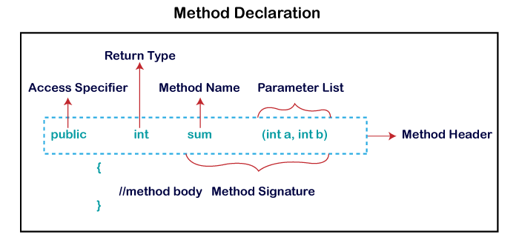
PRE-DEFINED METHOD
Method that is already defined in the Java class libraries is known as predefined methods.
Also called standard library method or built-in method.
Examples: length(), equals(), compareTo(), sqrt(), etc.
Import related package
The method written by the user or programmer is known as a user-defined method
We can modify the method according to our requirement.

Slide 109
Access Specifiers
Access Specifier:
Access specifier or modifier is the access type of the method. It specifies the visibility of the method. Java provides four types of access specifier:
Public: The method is accessible by all classes when we use public specifier in our application.
Private: When we use a private access specifier, the method is accessible only in the classes in which it is defined.
Protected: When we use protected access specifier, the method is accessible within the same package or subclasses in a different package.
Default: When we do not use any access specifier in the method declaration, Java uses default access specifier by default. It is visible only from the same package only.

Slide 110
Methods in Java
Return Type:
Return type is a data type that the method returns.
If the method does not return anything, we use void keyword.
Method Name:
It is a unique name that is used to define the name of a method.
A method is invoked by its name.
Parameter List:
It is the list of parameters separated by a comma and enclosed in the pair of parentheses. It contains the data type and variable name. If the method has no parameter, left the parentheses blank.
Method Body: It is a part of the method declaration. It contains all the actions to be performed. It is enclosed within the pair of curly braces.

Slide 111
Example
class Example
{
public static void main(String[] args)
{
int a = 15;
int b = 5;
Example e=new Example();
int c = e.minNumber(a, b);
System.out.println("Minimum Value = " + c);
}
public int minNumber(int n1, int n2)
{
int min;
if (n1 > n2)
min = n2;
else
min = n1;
return min;
}
}

Slide 112
CONSTRUCTORS
A constructor initializes an object when it is created.
we use a constructor to give initial values to the instance variables defined by the class, or to perform any other start-up procedures
It has the same name as the class in which it resides.
It is syntactically similar to a method
At the time of calling constructor, memory for the object is allocated in the memory.
Every time an object is created using the new() keyword, at least one constructor is called.
It calls a default constructor if there is no constructor available in the class. In such case, Java compiler provides a default constructor by default(initializes all member variables to zero)
Once we define our own constructor, the default constructor is no longer used.

Slide 113
Constructors
Rules for creating Java constructor
Constructor name must be the same as its class name
A Constructor must have no explicit return type
A Java constructor cannot be abstract, static, final, and synchronized
There are two types of constructors in Java:
No-arguments constructor
Parameterized constructor
Syntax:
class ClassName
{
ClassName()
{
}
}

Slide 114
NO-ARGUMENTS CONSTRUCTOR
No argument constructors of Java does not accept any parameters.
Instance variables of a method will be initialized with fixed values for all objects.
Syntax:
class ClassName {
ClassName()
{
var_name=value;
}
}
class Example
{
public static void main(String args[])
{
MyClass o1 = new MyClass();
MyClass o2 = new MyClass();
System.out.println(o1.num + " " +o2.num);
}
}
Output:
10 10

Slide 115
PARAMETERIZED CONSTRUCTOR
The parameterized constructor is used to provide different values to distinct objects. However, you can provide the same values also.
Accepts one or more parameters
Parameters are added to a constructor in the same way that they are added to a method
Syntax:
class ClassName {
ClassName(parameters )
{
var_name=value;
}
}
Example:
class MyClass
{
int x;
MyClass(int i )
{
x = i;
}
}
class Example
{
public static void main(String args[])
{
MyClass o1 = new MyClass(10);
MyClass o2 = new MyClass(20);
System.out.println(o1.num + " " + o2.num);
}
}

Slide 116


Slide 117
CONSTRUCTOR OVERLOADING
It is a technique of having more than one constructor with different parameter lists.
Each constructor performs a different task.
They are differentiated by the compiler by the number of parameters in the list and their types.

Slide 118
class Student{
int id;
String name;
int age;
Student(int i,String n)
{
id = i;
name = n;
}
Student(int i,String n,int a)
{
id = i;
name = n;
age=a;
}
void display(){System.out.println(id+" "+name+" "+age);}
public static void main(String args[]){
Student s1 = new Student(11,"Jyothi");
Student s2 = new Student(22,"Rama",25);
s1.display();
s2.display();
}
}
Output:
11 jyothi 0
22 Rama 25

Slide 119
METHOD OVERLOADING
Method overloading is one of the ways through which java supports polymorphism.
Polymorphism in Java is a concept by which we can perform a single action in different ways.
There are two types of polymorphism in Java: compile-time polymorphism and runtime polymorphism. We can perform polymorphism in java by method overloading and method overriding.
Compile Time Polymorphism: At compile-time, java knows which method to call by checking the method signatures. So this is called compile-time polymorphism or static or early binding. Compile-time polymorphism is achieved through method overloading.

Slide 120
METHOD OVERLOADING
Method Overloading is a technique which allows declaring multiple methods with same name but different parameters in the same class.
They are differentiated by the compiler by changing number of arguments or by changing the data type of arguments.
If two or more method have same name and same parameter list but differs in return type can not be overloaded.
There are two different ways of method overloading.
Different datatype of arguments
Different number of arguments

Slide 121
METHOD OVERLOADING BY CHANGING DATA TYPE OF ARGUMENTS.
class Calculate
{
void sum (int a, int b)
{
System.out.println("sum is"+(a+b)) ;
}
void sum (float a, float b)
{
System.out.println("sum is"+(a+b));
}
Public static void main (String[] args)
{
Calculate cal = new Calculate();
cal.sum (8,5); //sum(int a, int b) is method is called.
cal.sum (4.6f, 3.8f); //sum(float a, float b) is called.
}
}
You can see that sum() method is overloaded two times. The first takes two integer arguments, the second takes two float arguments.

Slide 122
METHOD OVERLOADING BY CHANGING NO. OF ARGUMENT
class Demo
{
void multiply(int l, int b)
{
System.out.println("Result is"+(l*b)) ;
}
void multiply(int l, int b,int h)
{
System.out.println("Result is"+(l*b*h));
}
public static void main(String[] args)
{
Demo a = new Demo();
a.multiply(8,5); //multiply(int l, int b) is method is called
a.multiply(4,6,2); //multiply(int l, int b,int h) is called
}
}
multiply() method is overloaded twice. The first method takes two arguments and the second method takes three arguments.

Slide 123

METHOD OVERLOADING AND TYPE PROMOTION
One type is promoted to another implicitly if no matching datatype is found.

Slide 124
METHOD OVERLOADING AND TYPE PROMOTION
class Example
{
void sum(int a,long b)
{
System.out.println(a+b);
}
void sum(int a,int b,int c)
{
System.out.println(a+b+c);
}
public static void main(String args[])
{
Example obj=new Example();
obj.sum(20,20);//now second int literal will be promoted to long
obj.sum(20,20,20);
}
}
Output:40
60

Slide 125
METHOD OVERLOADING AND TYPE PROMOTION
class Example
{
void sum(int a,int b)
{
System.out.println(a+b);
}
void sum(long a,long b)
{
System.out.println(a+b);
}
public static void main(String args[])
{
Example obj=new Example();
obj.sum(20,20);//now int arg sum() method gets invoked
}
}
Output:20
20

Slide 126
THIS KEYWORD
refers to “this” object (object in which it is used)
usage:
with an instance variable or method of “this” class
as a function inside a constructor of “this” class
as “this” object, when passed as parameter
refers to “this” object’s data member
class Weight {
int lb; int oz;
public Weight (int lb, int oz ) {
this.lb = lb; this.oz = oz;
}
}

Slide 127


Slide 128
USAGE OF THIS KEYWORD
This can be used to refer current class instance variable
This can be used to refer current class method(implicitly)
This() can be used to invoke current class constructor.
The this keyword can be used o refer current class instance variable. If there is ambiguity between the instance variable and parameters, this keyword resolves the problem of ambiguity.

Slide 129
UNDERSTANDING THE PROBLEM WITHOUT THIS KEYWORD
class Student{
int rollno;
String name;
float fee;
Student(int rollno,String name,float fee){
rollno=rollno;
name=name;
fee=fee;
}
void display(){System.out.println(rollno+" "+name+" "+fee);}
}
class TestThis1{
public static void main(String args[]){
Student s1=new Student(111,"ankit",5000f);
Student s2=new Student(112,"sumit",6000f);
s1.display();
s2.display(); }}
Output:
0 null 0.0
0 null 0.0
Here, parameters (formal arguments) and instance variables are same. So, we are using this keyword to distinguish local variable and instance variable.

Slide 130
SOLUTION OF THE ABOVE PROBLEM BY THIS KEYWORD
class Student{
int rollno;
String name;
float fee;
Student(int rollno,String name,float fee){
this.rollno=rollno;
this.name=name;
this.fee=fee;
}
void display(){System.out.println(rollno+" "+name+" "+fee);}
}
class TestThis2{
public static void main(String args[]){
Student s1=new Student(111,"ankit",5000f);
Student s2=new Student(112,"sumit",6000f);
s1.display();
s2.display(); }}
If local variables(formal arguments) and instance variables are different, there is no need to use this keyword
Output:
111 ankit 5000
112 sumit 6000

Slide 131
PROGRAM WHERE THIS KEYWORD IS NOT REQUIRED
class Student{
int rollno;
String name;
float fee;
Student(int r,String n,float f){
rollno=r;
name=n;
fee=f;
}
void display(){System.out.println(rollno+" "+name+" "+fee);}
}
class TestThis3{
public static void main(String args[]){
Student s1=new Student(111,"ankit",5000f);
Student s2=new Student(112,"sumit",6000f);
s1.display();
s2.display(); }}

Slide 132
THIS: TO INVOKE CURRENT CLASS METHOD
You may invoke the method of the current class by using the this keyword.
If you don't use the this keyword, compiler automatically adds this keyword while invoking the method.

Slide 133

EXAMPLE

Slide 134
EXAMPLE
class A
{
void m()
{
System.out.println("hello m");
}
void n()
{
System.out.println("hello n");
this.m();
}
}
class TestThis4{
public static void main(String args[]){
A a=new A();
a.n();
}}
Output:
hello n
hello m
hello m

Slide 135
CALLING PARAMETERIZED CONSTRUCTOR FROM DEFAULT CONSTRUCTOR:
class A{
A()
{
this(5);
System.out.println("hello a");
}
A(int x)
{ Parameterized constructor
System.out.println(x);
}
}
class TestThis6{
public static void main(String args[]){
A a=new A();
}} Output:
5
hello a

Slide 136
Example
class Student{
int rollno;
String name,course;
float fee;
Student(int rollno,String name,String course){
this.rollno=rollno;
this.name=name;
this.course=course; }
Student(int rollno,String name,String course,float fee){
this(rollno,name,course);//reusing constructor
this.fee=fee; }
void display(){System.out.println(rollno+" "+name+" "+course+" "+fee);}
}
class TestThis7{
public static void main(String args[]){
Student s1=new Student(111,"ankit","java");
Student s2=new Student(112,"sumit","java",
6000f);
s1.display();
s2.display(); }}
Output:
111 ankit java null
112 sumit java 6000

Slide 137

“STATIC” KEYWORD
The static keyword in Java is used for memory management mainly.
The static keyword belongs to the class than an instance of the class.
The “static” Keyword can be applied to:
Variable (also known as a instance variable)
Block
Method
Nested class

Slide 138
TO VARIBALE
Java static variable:
If you declare any variable as static, it is known as a static variable.
The static variable can be used to refer to the common property of all objects (which is not unique for each object)
for example: company name of employees
The static variable gets memory only once in the class area at the time of class loading
It makes your program memory efficient (i.e., it saves memory).
Syntax: static variable_name=value;

Slide 139
TO VARIBALE
class Student{
int rollno;
String name;
String company=“Pennant";
}
If we make college filed static, this field will get the memory only once.
class Student{
int rollno;
String name;
static String company=“Pennant";
}
Java static property is shared to all objects.

Slide 140
TO VARIBALE
class Student{
int rollno;
String name;
static String company ="Pennant";//static variable
Student(int r, String n){
rollno = r;
name = n; }
void display (){System.out.println(rollno+" "+name+" "+company);}
}
public class TestStaticVariable1{
public static void main(String args[]){
Student s1 = new Student(111,"AKHILA");
Student s2 = new Student(222,"PRAGADA");
s1.display();
s2.display(); } }
Output:
111 AKHILA Pennant
222 PRAGADA Pennant

Slide 141
TO VARIBALE
class Counter{
int count=0;//will get memory each time when the instance is created
Counter(){
count++;//incrementing value
System.out.println(count);
}
public static void main(String args[]){
//Creating objects
Counter c1=new Counter();
Counter c2=new Counter();
Counter c3=new Counter();
} }
Output:
1
1
1

Slide 142
TO VARIBALE
will get memory only once and retain its value
class Counter2{
static int count=0;
Counter2(){
count++;//incrementing the value of static variable
System.out.println(count);
}
public static void main(String args[]){
//creating objects
Counter2 c1=new Counter2();
Counter2 c2=new Counter2();
Counter2 c3=new Counter2();
} }
Output:
1
2
3

Slide 143
TO BLOCK
A static block is used for initializing static variables.
The static block is executed once when the first object of the class is created.
Syntax:
static
{
//code
}

Slide 144
TO METHOD
If you apply static keyword with any method, it is known as static method.
A static method belongs to the class rather than the object of a class.
A static method can be invoked without the need for creating an instance of a class.
A static method can access static data member and can change the value of it.
class Student{
int rollno;
String name;
static String company = “Pennant";
//static method to change the value of static variable
static void change(){
company = “Pennanttech";
}

Slide 145
TO METHOD
class Calculate{
static int cube(int x){
return x*x*x;
}
public static void main(String args[])
{
int result=Calculate.cube(5);
System.out.println(result);
}
}
Output:
125

Slide 146
TO METHOD
Restrictions for the static method
The static method can not use non static data member or call non-static method directly.
this and super cannot be used in static context.
Java main method is static? because the object is not required to call a static method. If it were a non-static method, JVM creates an object first then call main() method that will lead the problem of extra memory allocation.
class A{
int a=40;//non static
public static void main(String args[]){
System.out.println(a);
}
}
Output:
Compile Time Error

Slide 147
JAVA MAIN METHOD IS STATIC?
Java main() method is always static, so that compiler can call it without the creation of an object or before the creation of an object of the class.
In any Java program, the main() method is the starting point from where compiler starts program execution. So, the compiler needs to call the main() method.
If the main() is allowed to be non-static, then while calling the main() method JVM has to instantiate its class.
While instantiating it has to call the constructor of that class, There will be ambiguity if the constructor of that class takes an argument.
Static method of a class can be called by using the class name only without creating an object of a class.
The main() method in Java must be declared public, static and void. If any of these are missing, the Java program will compile but a runtime error will be thrown.

Slide 148

FINAL KEYWORD
The final keyword is a non access modifier used for classes , attributes and methods, which makes them non changeable.
(impossible to inherit or override)
The final keyword is useful when you want a variable to always store the same value like PI(3.14)
The final key word is a modifier.

Slide 149
FINAL KEYWORD
The final keyword in java is used to restrict the user. The java final keyword can be used in many contexts.
Variable
Method
Class
It can be applied with the variables , a final variable that have no value it is called blank final variable or uninitialized variable .
It can be initialized in the constructor only.
The blank final variable can be static also which will be initialized in the static block only.

Slide 150
FINAL VARIABLE
If you make any variable as final, you cannot change the value of final variable (it will be constant)
Ex: there is a final variable speed limit, we are going to change the value of this variable.
But, it cannot be changed because final variable once assigned a value can never be changed.

Slide 151
EXAMPLE
class Bike
{
final int speedlimit=90;
void run()
{
speedlimit=400;
}
public static void main(String args[])
{
Bike obj= new Bike();
obj.run();
} }
Output: Compile time error

Slide 152
FINAL METHOD
class Bike
{
final void run()
{
System.out.println("running");
}
class Honda extends Bike
{
void run()
{
System.out.println("running safely with 100 kmph");
}
public static void main(String args[])
{
Honda honda = new Honda();
honda.run();
} }} Output: Compile time error

Slide 153
IS FINAL METHOD INHERITED?
Class Bike
{
final void run()
{
System.out.println(“running…”);
}
Class Honda2 extends Bike
{
public static void main(String args[])
{
New Honda2().run();
}
}
Output: running…

Slide 154
WHAT IS BLANK OR UNINITIALIZED FINAL VARIABLE?
A final variable that is not initialized at the time of declaration is known as blank final variable.
If you want to create a variable that is initialized at the time of creating object and once initialized may not be changed, it is useful.
For example, PAN CARD number of an employee.
It can be initialized only in constructor.
Ex: class Student
{
int id;
String name;
final String PAN_CARD_NUMBER;
}

Slide 155
CAN WE INITIALIZE BLANK FINAL VARIABLE?
Yes, but only in constructors
class Bike10{
final int speedlimit;//blank final variable
Bike10(){
speedlimit=70;
System.out.println(speedlimit);
}
public static void main(String args[]){
new Bike10();
}
}
Output: 70

Slide 156
GARBAGE COLLECTION
Java garbage collection is the process by which Java programs perform automatic memory management.
Java programs compile to bytecode that can be run on a Java Virtual Machine, or JVM for short.
When Java programs run on the JVM, objects are created on the heap, which is a portion of memory dedicated to the program.
Eventually, some objects will no longer be needed.
The garbage collector finds these unused objects and deletes them to free up memory.

Slide 157
GARBAGE COLLECTION
In java, garbage means unreferenced objects.
Garbage Collection is process of reclaiming the runtime unused memory automatically. In other words, it is a way to destroy the unused objects.
To do so, we were using free() function in C language and delete() in C++. But, in java it is performed automatically. So, java provides better memory management.
Advantage of Garbage Collection
It makes java memory efficient because garbage collector removes the unreferenced objects from heap memory.
It is automatically done by the garbage collector(a part of JVM) so we don't need to make extra efforts.

Slide 158


Slide 159
How can an object be unreferenced?
By nulling a reference:
Employee e= new Employee();
e=null;
By assigning a reference to another:
Employee e1= new Employee();
Employee e2= new Employee();
e1=e2;
//now the first object is referred by e1 is available for garbage collection
By anonymous object:
new Employee();

Slide 160
HOW IT WORKS?
Java garbage collection is an automatic process.
The programmer does not need to explicitly mark objects to be deleted.
The garbage collection implementation lives in the JVM.
Each JVM can implement garbage collection however it pleases; the only requirement is that it meets the JVM specification.
Although there are many JVMs, Oracle’s HotSpot is by far the most common. It offers a robust and mature set of garbage collection options.
While HotSpot has multiple garbage collectors that are optimized for various use cases, all its garbage collectors follow the same basic process.

Slide 161
CONTD…
In the first step, unreferenced objects are identified and marked as ready for garbage collection.
In the second step, marked objects are deleted.
Optionally, memory can be compacted after the garbage collector deletes objects, so remaining objects are in a contiguous block at the start of the heap.
The compaction process makes it easier to allocate memory to new objects sequentially after the block of memory allocated to existing objects.
All of HotSpot’s garbage collectors implement a generational garbage collection strategy that categorizes objects by age.
The rationale behind generational garbage collection is that most objects are short-lived and will be ready for garbage collection soon after creation.

Slide 162
FINALIZE() METHOD
The java.lang.Object.finalize() is called by the garbage collector on an object when garbage collection determines that there are no more references to the object. A subclass overrides the finalize method to dispose of system resources or to perform other cleanup.
Declaration
Following is the declaration for java.lang.Object.finalize() method
protected void finalize()
Parameters
NA
Return Value
This method does not return a value.
Exception
Throwable − the Exception raised by this method

Slide 163
EXAMPLE
The following example shows the usage of lang.Object.finalize() method.
import java.util.*;
public class ObjectDemo extends GregorianCalendar {
public static void main(String[] args) {
try {
ObjectDemo cal = new ObjectDemo();
System.out.println("" + cal.getTime());
System.out.println("Finalizing...");
cal.finalize();
System.out.println("Finalized."); }
catch (Throwable ex) {
ex.printStackTrace(); }
} }
Output: Sat Sep 22 00:27:21 EEST 2012
Finalizing...
Finalized.

